Slide 1
Spring Boot Series – Day 6
Topic: Spring Boot DevTools & Profiles
@CodeByHaindavi | #SpringWithMe

Slide 2
Why DevTools?
✔️ When you're actively developing a Spring Boot app, even a tiny code change often means stopping, restarting, and waiting — over and over again. ✔️ And it's not just code — things like Thymeleaf templates or static assets (CSS, JS) can get cached, forcing you to manually refresh or clear browser cache. ✔️ These small interruptions break your rhythm and slow you down. DevTools solves this by enabling automatic restarts, live reloads, and disabling cache — so you can focus on building, not reloading.
@CodeByHaindavi | #SpringWithMe

Slide 3
What DevTools Offers?
🔁 It automatically restarts your application whenever it detects code changes — no manual relaunch needed. 🧠 Caching is turned off for templates like Thymeleaf, so updates show instantly during development. 📂 Static resources like CSS and JS reload in real-time — great for frontend tweaks. 📡 It also supports remote debugging setups if you're working across machines or containers.
@CodeByHaindavi | #SpringWithMe

Slide 4
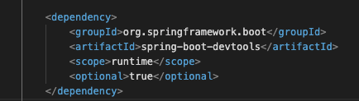
How to Add DevTools?
✔️ To use Spring Boot DevTools, just add this dependency to your pom.xml
✔️ Spring Boot will automatically enable DevTools features only in development mode (not in production), so you don't have to toggle anything manually.
⚡No annotations, no config — just add and code faster.
@CodeByHaindavi | #SpringWithMe

Slide 5
Why Spring Profiles?
✔️ In real-world projects, dev, test, and prod environments need different settings — like databases, ports, logging levels, or email services. ✔️ Hardcoding or using if-else for these variations becomes messy and error-prone. ✔️ Spring Profiles let you cleanly separate configs using application-dev.properties, application-prod.properties, etc. ✔️ Just switch the profile, and your app behaves exactly the way that environment needs — no code change required.
@CodeByHaindavi | #SpringWithMe

Slide 6

How Spring Boot Handles Profiles?
✔️ Spring Boot automatically loads the right config file based on the active profile — like dev, test, or prod. ✔️ By switching the profile name, you can change environment-specific settings like DBs, ports, or log levels — without touching the code. ✔️ It keeps your project clean, modular, and ready for any deployment.
@CodeByHaindavi | #SpringWithMe

Slide 7
Use Case: Switching DB or Ports
🔧 Your development setup might use H2 for quick testing, while production needs a secure MySQL or Postgres database.
🌐 You may want different ports (e.g., 8081 in dev, 80 in prod) or different log levels (DEBUG vs ERROR).
🔍 With Spring Profiles, you don’t need if-else or separate code — just switch the profile, and Spring handles the rest.
@CodeByHaindavi | #SpringWithMe

Slide 8
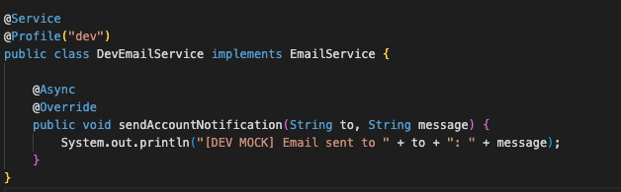
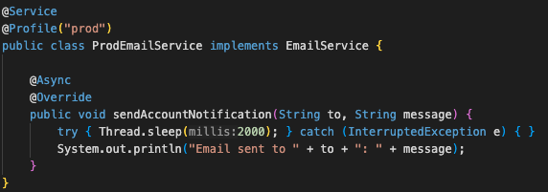
@Profile Annotation
✔️ When you want Spring to load a bean only in a specific environment, @Profile("dev") or @Profile("prod") helps. ✔️ For example, your mock DevEmailService should load in dev, but never in prod — and @Profile ensures exactly that. ✔️ It keeps environment-specific logic clean, safe, and easy to switch — without touching any business code.
@CodeByHaindavi | #SpringWithMe

Slide 9


Profile-Based Bean Switching
✔️ Spring injects the right version of EmailService based on the active profile. ✔️ The interface keeps things flexible, while application.properties decides whether to use dev or prod logic. ✔️ No code changes needed — just switch the profile to change behavior safely.
@CodeByHaindavi | #SpringWithMe

Slide 10
💼 Interview Insight
Can we use profiles for logging or security configs too?
• Yes, you can separate logging levels, DB settings, and even security behavior across application-{profile}.properties files — keeping environments isolated without code duplication.
Can DevTools be used in production?
• No — it's disabled automatically for safety.
What happens if multiple profiles are active at once?
• Spring will activate all the matching beans, and if the same property exists in multiple profiles, the last one listed takes precedence. This allows layered overrides like default → dev → local.
How can you load profile-specific beans conditionally?
• You annotate the class or method with @Profile("profileName"). Spring only loads that bean when the specified profile is active — keeping your context clean and modular.
@CodeByHaindavi | #SpringWithMe

Slide 11
📌 Recap – Day 6
✔️ DevTools makes development smoother with auto-restart and live reload — no more manual refreshes. ✔️ Spring Profiles help cleanly separate dev, test, and prod configurations. ⚙️ @Profile loads only the beans needed for the current environment — keeping your app lightweight and safe. ✔️ Together, they make your app flexible, testable, and environment-aware.
👉 Coming up next: Spring Boot Logging & Logback Configuration
@CodeByHaindavi | #SpringWithMe

